Slide 1
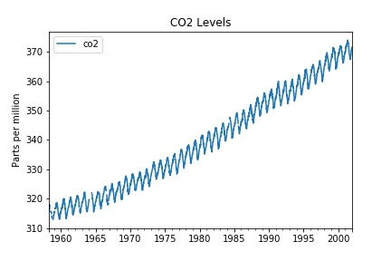
The main purpose of time series is to show how data has changed with time and to show the trends and make future predictions.
The most important part is to choose the correct time range and measurement units as both of these can give the wrong impression of what the data means if the wrong interval is chosen.

